Slide 1
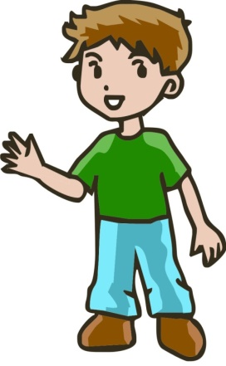
In The Classroom
I struggle to use classroom equipment such as scissors, ruler or stapler.
I struggle to copy from the board.
I may have an immature pencil grasp or swap the hand I hold the pencil with.
I am as clever as my peers.
If you see me,
I might have Developmental Coordination Disorder.
A referral to
Occupational Therapy
could benefit me.
Around School
I often trip, fall, walk into or drop things.
I may appear clumsy, awkward or inefficient with my movements
It takes a lot of effort for me to learn new motor activities. I find it easier if you break them into smaller steps or let me have more time.
Although I may ‘get there’, I often struggle to learn new motor activities and so may prefer to do things I’ve already learnt instead of learning new motor skills
My Day
Everyday activities such as getting dressed, tying shoe laces, buttons or zips are really difficult.
I’m friendly and sociable and want to join in but find sports or outdoor play difficult.
I can be a messy eater. I struggle to use a knife and fork, often knock over my glass and spill food when eating.
Moving and shaking
I look clumsy when I run and find it difficult to hop, skip and balance.
I have difficulties with more complex activities such as swimming or riding a bike.
Contact Us
Occupational Therapy Department Coral House 11 Longbow Close Harlescott Lane Shrewsbury SY1 3GZ Tel: 01743 450800 Email: shropcom.OT4kids@nhs.net

